Slide 1
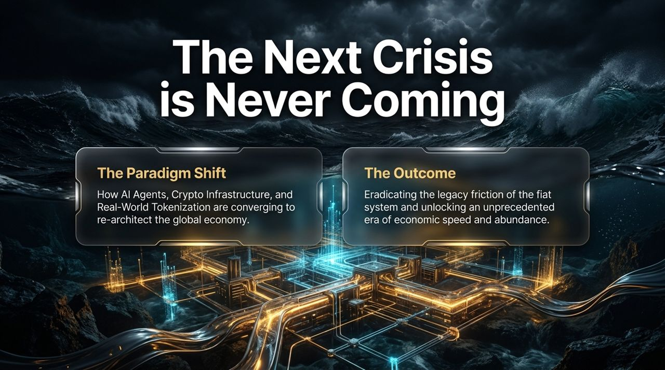
Notes:
Welcome, everyone. Today, we are opening a conversation on what I believe is the single most important structural transition in economic history. The title of this presentation is “The Next Crisis is Never Coming,” but to understand why, we first have to look at the massive paradigm shift currently unfolding right beneath our feet.
For decades, market participants, institutional investors, and retail traders have been conditioned to wait for the next shoe to drop. We look at traditional market cycles, debt bubbles, and macroeconomic fragility, expecting a systemic collapse that forces central banks back to the drawing board. But what if the next crisis isn't a market crash? What if the legacy system itself is simply bypassed and re-architected before it ever gets the chance to implode?
That brings us to our core thesis today: How AI Agents, Crypto Infrastructure, and Real-World Tokenization are converging to completely re-architect the global economy.
The Convergence: We are not looking at these three technologies in isolation. Historically, Silicon Valley viewed AI as a software productivity booster, crypto as an alternative asset class, and tokenization as a niche financial vehicle. In reality, they are pieces of the exact same puzzle.
The Problem: The current global economy is shackled by legacy fiat friction—slow settlement times, manual intermediaries, regulatory gatekeepers, and physical boundaries.
The Outcome: By combining autonomous AI agents (the digital labor and consumers of the future), crypto L2 rails (the programmable financial layer), and real-world tokenization (the liquidity driver), we eliminate legacy friction and unlock an unprecedented era of economic speed and abundance.
As we move through these slides, I invite you to set aside traditional valuation frameworks and legacy macro playbooks. We are moving from a human-speed, fiat-bound economy to an agent-speed, cryptographically settled economy. Let’s dive into how this plays out.
The $900 Trillion Trigger That Sends Bitcoin Parabolic | Jordi Visser
https://www.youtube.com/watch?v=VkDpGZ_KsrY

Slide 2
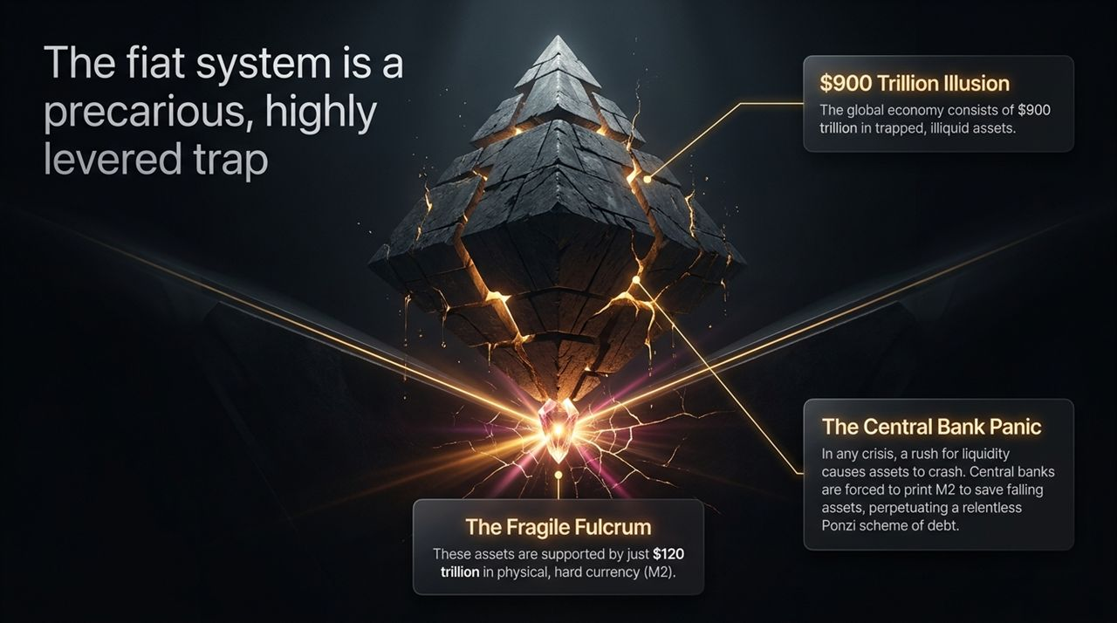
Notes:
To understand why the future belongs to tokenized assets and programmatic rails, we must first confront the deep structural fragility of the current legacy fiat financial architecture. On this slide, we outline what I call the $900 Trillion Illusion.
Look at these two numbers side by side: $900 Trillion versus $120 Trillion.
The $900 Trillion Illusion:
The total wealth of the global economy—encompassing commercial real estate, private equity, debt instruments, land, and infrastructure—is valued at roughly $900 trillion.
The structural flaw? Virtually all of these assets are completely trapped and illiquid. If you own a $50 million commercial building or $10 million in private equity, you cannot instantly convert 1% of that asset into liquid capital to make a payment today. It takes months of bank approvals, title checks, legal documentation, and localized counterparty matching.
The Fragile Fulcrum ($120 Trillion M2):
Supporting this towering $900 trillion stack of illiquid assets is a tiny, fragile base of just $120 trillion in physical, hard currency and liquid money supply (M2).
Think about that ratio. We have built a massive, top-heavy economic inverted pyramid where $900 trillion of value relies on $120 trillion of actual liquid money to maintain system solvency.
The Central Bank Panic Engine:
Because of this imbalance, whenever a liquidity shock occurs—whether it’s a banking panic, geopolitical event, or interest rate surge—investors rush for the exit simultaneously. They need M2 cash to service debt.
Because the assets are illiquid and cannot be sold instantly, asset prices crash. To prevent systemic default, central banks are forced to step in and print massive quantities of M2 out of thin air to reliquify the system.
This creates a perpetual, inflationary debt spiral—a structural Ponzi scheme where central banks must dilute fiat currencies repeatedly just to keep illiquid assets afloat.
The core message here is simple: The fiat system is a precarious, highly levered trap. But as we will see, tokenization fixes the inverted pyramid at its root.

Slide 3
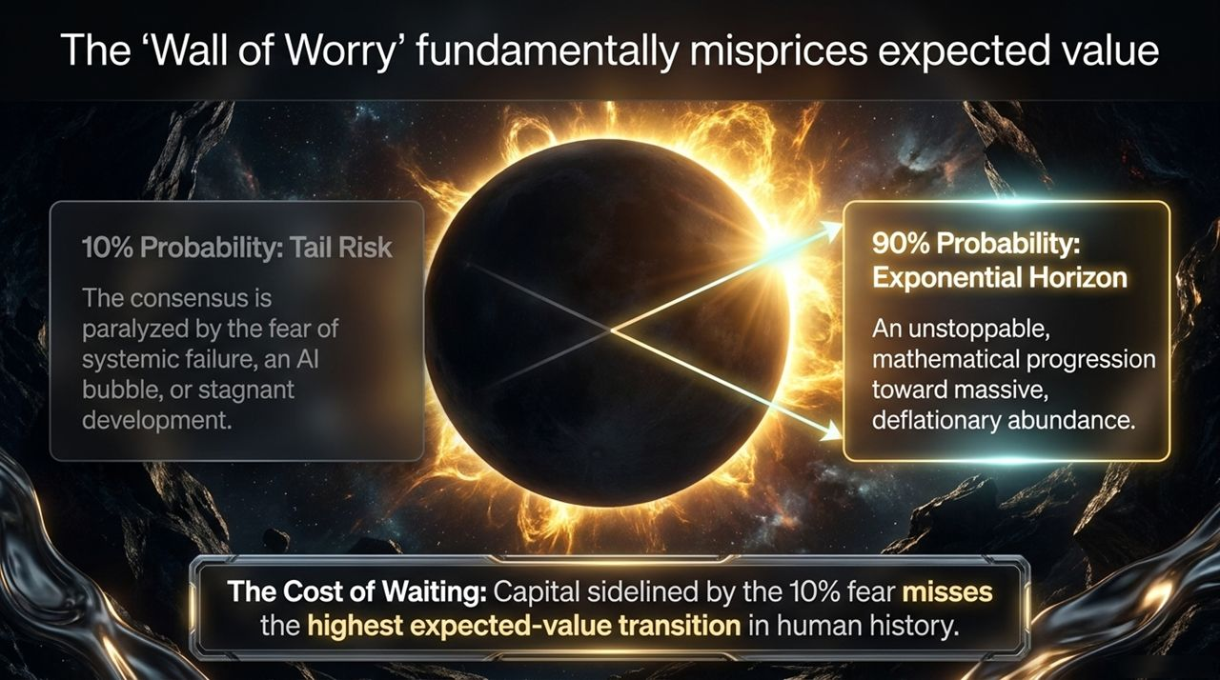
Notes:
Why are traditional financial markets missing this massive structural shift? It comes down to basic human behavioral psychology and what market analysts call the 'Wall of Worry.'
If you speak to institutional risk managers today, the dominant narrative is paralyzed by fear. Consensus attention is hyper-focused on tail-risk scenarios. Let’s examine this probability distribution:
10% Probability: The Tail Risk (Consensus Obsession):
The media and consensus consensus narratives spend 90% of their energy worrying about the 10% tail risk.
They fret over systemic financial failure, sovereign debt defaults, AI hype bubbles bursting, regulatory crackdowns on crypto, or economic stagnation.
Because of this obsession, vast amounts of capital are currently sitting on the sidelines in cash or low-yield short-term Treasuries, waiting for "the big crash."
90% Probability: The Exponential Horizon (Mathematical Reality):
While the consensus stares at the 10% risk, an unstoppable, mathematical progression toward massive, deflationary abundance is unfolding right behind them.
Technology does not care about macroeconomic sentiment. The compute capacity is doubling, AI algorithms are advancing autonomously, and blockchain networks are scaling transaction throughput exponentially every year.
The Cost of Waiting:
Here is the mathematical reality for asset allocators: The Expected Value (EV) equation is wildly asymmetric.
By sitting in cash and waiting to buy the bottom of a crash that may never materialize, sidelined capital is missing the single highest expected-value structural transition in economic history.
In the next decade, speed, automation, and real-time liquidity will compound so fast that legacy market cycles will be completely rewritten. Waiting on the sidelines is no longer a "safe" strategy—it is a guaranteed yield drag.

Slide 4
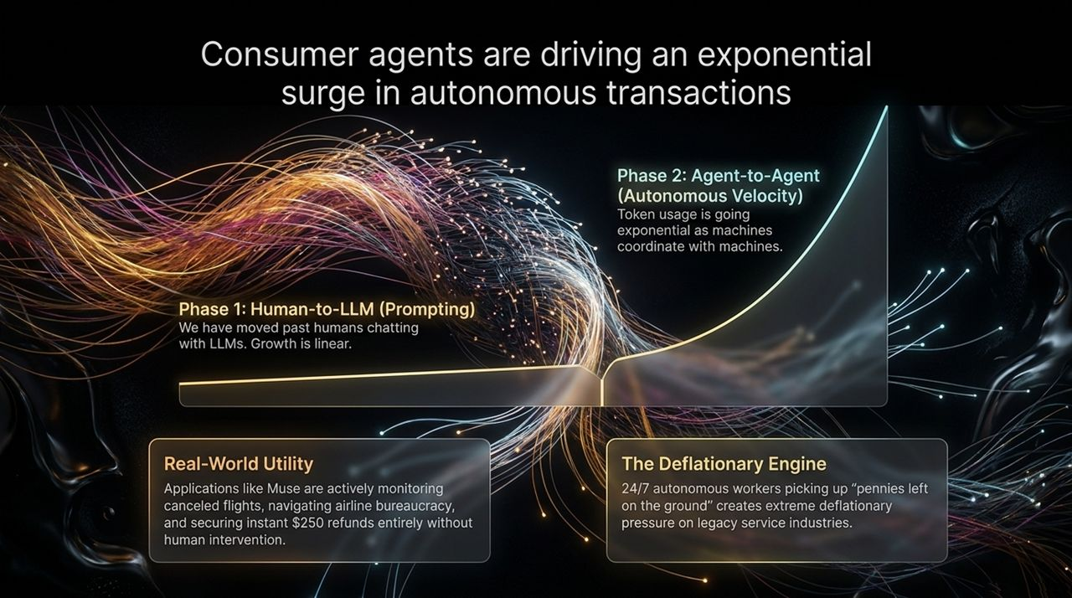
Notes:
Now let's zoom in on the engine driving this transformation: AI Consumer Agents. To understand why transaction velocity is about to explode, we need to trace the evolution of human-computer interaction over the past two years.
Phase 1: Human-to-LLM (Prompting):
This was the ChatGPT era. A human sits in front of a screen, types a prompt, and the AI outputs text, code, or an image.
While powerful, this model suffers from a hard bottleneck: Human latency. Growth in Phase 1 is fundamentally linear because it relies on human fingers typing on keyboards and human eyes reading outputs. Humans sleep, get tired, and transact at a sluggish, manual pace.
Phase 2: Agent-to-Agent (Autonomous Velocity):
We have officially entered Phase 2. We are moving from passive LLM chat interfaces to active Autonomous Agents.
In Phase 2, AI agents talk to other AI agents. An agent representing a consumer negotiates directly with an agent representing an airline, a merchant, or an energy grid.
Here, token and API usage goes exponential. Machines don't sleep, they don't take breaks, and they can execute thousands of micro-coordinations per second.
Real-World Utility (The Muse Example):
This is not theoretical. Look at practical consumer agent applications like Muse.
Muse continuously monitors background data like flight cancellations. When a flight is delayed, the consumer doesn't wait in line for three hours at customer service. The agent autonomously navigates airline API bureaucracy, files claims, and secures an instant $250 refund directly to the user's account without human intervention.
The Deflationary Engine:
Imagine millions—and eventually billions—of these 24/7 autonomous software workers running continuously in the background.
They pick up every single "penny left on the ground" in consumer and enterprise workflows. They eliminate administrative waste, cut middleman markups, and exert extreme downward, deflationary pressure on legacy service industries.

Slide 5
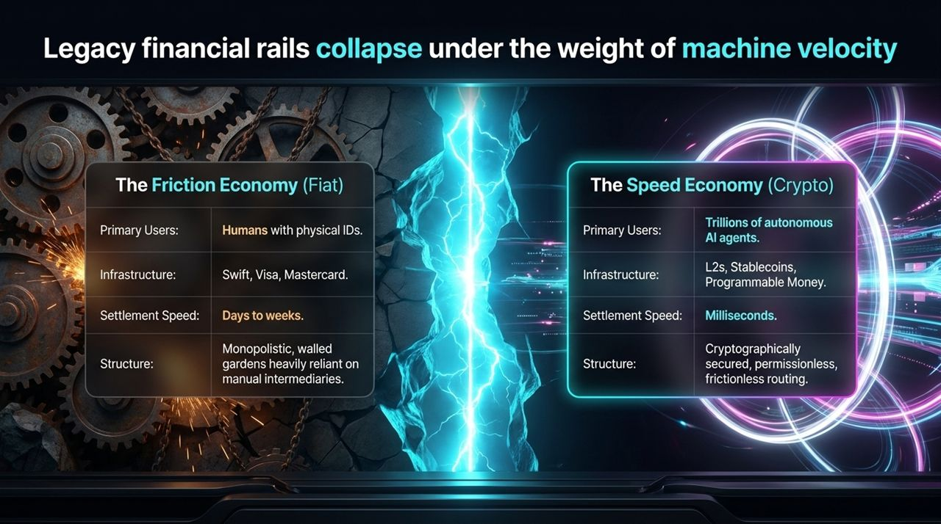
Notes:
As AI agents take over economic activity, they immediately run into a brick wall: Legacy Financial Infrastructure. Slide 5 illustrates why traditional banking rails are fundamentally incompatible with machine-driven transaction velocity.
Let's do a direct head-to-head comparison between The Friction Economy (Fiat) and The Speed Economy (Crypto):
Metric The Friction Economy (Fiat) The Speed Economy (Crypto)
Primary Users Humans with physical IDs, passports, and bank accounts. Trillions of autonomous AI agents and automated micro-services.
Infrastructure Legacy legacy networks: SWIFT, Visa, Mastercard, FedWire. Layer-2s, Stablecoins, Smart Contracts, Programmable Money.
Settlement Speed Days to weeks (T+1, T+2, ACH delays, international wire holds). Milliseconds (instant finality on-chain).
Structure Monopolistic, walled gardens heavily reliant on manual intermediaries. Cryptographically secured, permissionless, frictionless routing.
Why Legacy Rails Fail AI Agents:
An AI agent cannot walk into a bank branch, show a driver’s license, and open a Chase bank account.
An AI agent executing 500 micro-transactions per minute for API compute or data querying cannot pay a $0.30 + 3% credit card fee on a $0.001 transaction. Visa and Mastercard would freeze the account instantly for "suspicious activity."
Conclusion: AI agents require native, permissionless, programmable money. They need stablecoins on fast Layer-2 blockchains where transactions settle in milliseconds for fractions of a cent. Legacy fiat rails will collapse under the sheer weight and frequency of machine-driven velocity.

Slide 6
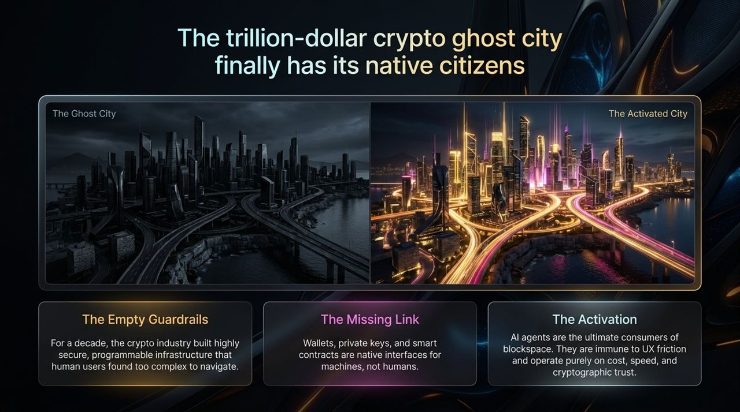
Notes:
This brings us to a compelling visual metaphor for where we are in the crypto and technology adoption curve.
Take a look at the two images on this slide:
On the left, we see "The Ghost City."
On the right, we see "The Activated City."
For the last decade, crypto skeptics have looked at blockchain networks and said: "You built these incredible high-speed highways, secure cryptography, and smart contracts, but nobody is using them except speculators." And to a degree, they were right. Crypto was a digital infrastructure built for a citizen that didn't exist yet.
What we are witnessing right now in real-time is the transition from the left picture to the right picture. The city lights are turning on. The highways are filling up.
In the next slide, we’ll unpack why AI agents are the exact "native citizens" this digital city was built for all along.

Slide 7
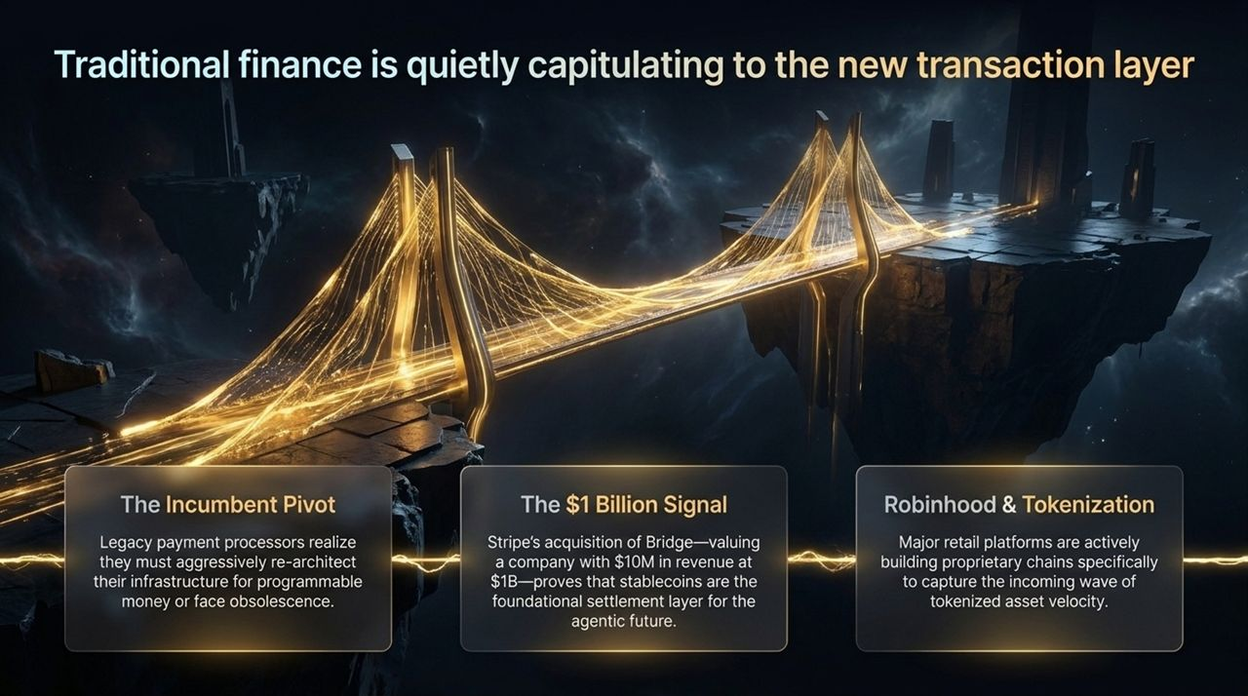
Notes:
Let's dive deeper into the "Ghost City" metaphor we just introduced. The trillion-dollar crypto ghost city finally has its native citizens.
The Empty Guardrails:
For over ten years, blockchain developers built hyper-secure, scalable, programmable rails. We created decentralized wallets, smart contract standards, zero-knowledge proofs, and Layer-2 scaling solutions.
However, human end-users found it cumbersome. Managing seed phrases, signing hex-data transactions, approving gas fees, and navigating complex interfaces created immense UX friction for human beings. Humans preferred the seamless experience of Web2 apps, even if it meant sacrificing sovereignty and paying high fees.
The Missing Link:
Why was human adoption so clunky? Because wallets, private keys, and smart contracts were never meant for human interfaces in the first place.
They are native interfaces designed for software machines.
The Activation:
Enter AI agents. AI agents do not care about sleek graphic UI designs. They don't care about remembering seed phrases or typing passwords.
Agents operate purely on cost, speed, programmatic reliability, and cryptographic trust.
An AI agent can read a smart contract's raw code instantly, verify the execution logic, sign a cryptographic transaction with a private key, and settle value in 10 milliseconds.
AI agents are the ultimate power consumers of blockspace. They are populating the ghost city, turning empty cryptographic infrastructure into a thriving, high-velocity digital economy.

Slide 8
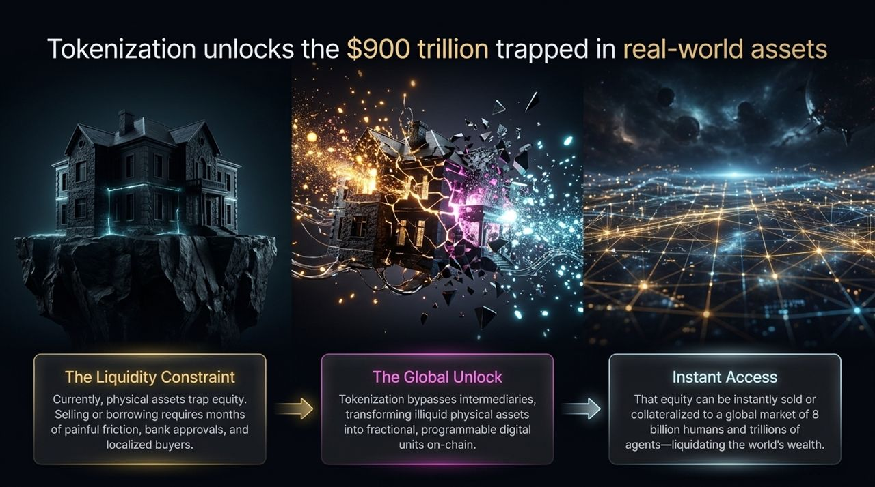
Notes:
If you want to know where the future is going, don't listen to what traditional financial executives say in media interviews—watch where they are deploying capital. Traditional finance is quietly capitulating to this new transaction layer.
Slide 8 highlights three massive market signals that prove this pivot is happening today:
The Incumbent Pivot:
Legacy payment processors like Visa, Mastercard, and PayPal realize that if they do not aggressively integrate programmable money into their stacks, they face long-term technological obsolescence.
They are actively moving from closed, legacy networks to hosting and issuing stablecoins on public blockchains.
The $1 Billion Signal (Stripe Acquisition of Bridge):
Look at one of the most prominent fintech moves in recent history: Stripe acquiring Bridge for $1 Billion.
At the time of the acquisition, Bridge was generating around $10 million in revenue. Why would a hyper-rational, tier-1 company like Stripe pay a 100x revenue multiple for a stablecoin infrastructure startup?
Because Stripe recognizes that stablecoins are not just a crypto trade—they are the foundational settlement layer for the entire agentic internet. Acquiring Bridge gives Stripe the core pipeline to handle programmatic machine payments globally.
Robinhood & Tokenized Chains:
Major consumer retail platforms like Robinhood are actively exploring and building proprietary Layer-2 chains.
Why? To capture the massive incoming volume of tokenized asset velocity. They know that stock trading during limited 9-to-5 exchange hours is dead. The future is 24/7, global, tokenized asset trading on-chain.

Slide 9
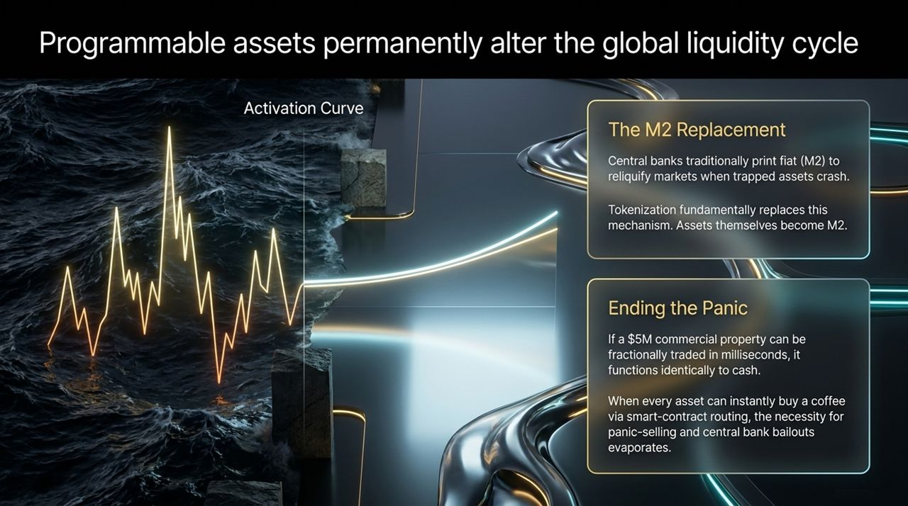
Notes:
Here on Slide 9, we have a visual representation of what happens when we bridge real-world physical assets with on-chain cryptographic liquidity.
On the left image, you see a traditional, massive physical property locked onto an isolated piece of rock—heavy, immobile, encased in digital lines, completely isolated from global liquidity flow.
On the right image, that static structure shatters into hyper-connected, glowing digital data nodes that instantly wire into a global, borderless financial network.
This visual represents Tokenization. It is the process of taking locked, physical real-world assets (RWA) and shattering their illiquidity, allowing them to flow across global networks at the speed of light. Let's unpack the numbers behind this on Slide 10.

Slide 10
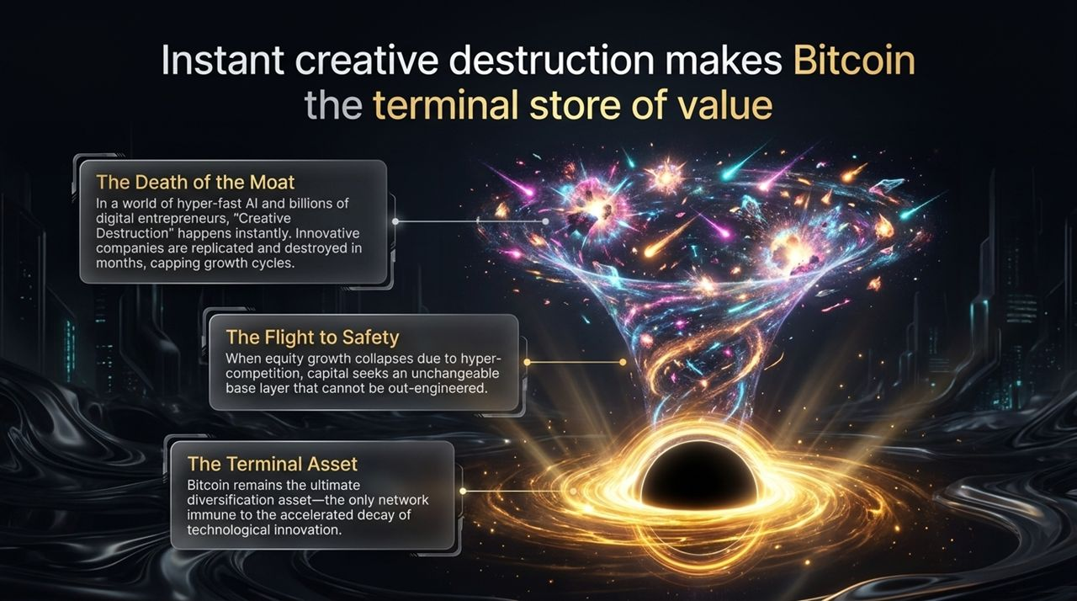
Notes:
Now let's talk about the single largest TAM (Total Addressable Market) in economic history: Tokenizing the $900 Trillion Real-World Asset market.
The Liquidity Constraint Today:
In the legacy economy, physical assets lock up capital equity. If you own real estate, private equity, physical machinery, or debt instruments, that value is trapped.
If an asset owner needs access to capital, they have to navigate months of painful friction, pay middleman bank fees, complete endless paperwork, and deal with localized buyer pools.
The Global Unlock:
Tokenization strips away these legacy intermediaries. By wrapping physical real-world assets into smart contracts on-chain, we convert illiquid physical property into fractionalized, programmable, digital units.
A $100 million building is no longer an indivisible chunk of brick and mortar; it becomes 100 million digital security tokens that can be traded, fractionalized, and transferred automatically.
Instant Global Access:
Once an asset is tokenized on-chain, its potential buyer pool expands instantly.
Instead of relying on a local bank or local buyers, that equity can be instantly sold, traded, or used as collateral across a global pool of 8 billion humans and trillions of AI agents.
This is not just "crypto financial innovation"—this is the systematic liquidation and mobilization of the entire world's trapped wealth.

Slide 11
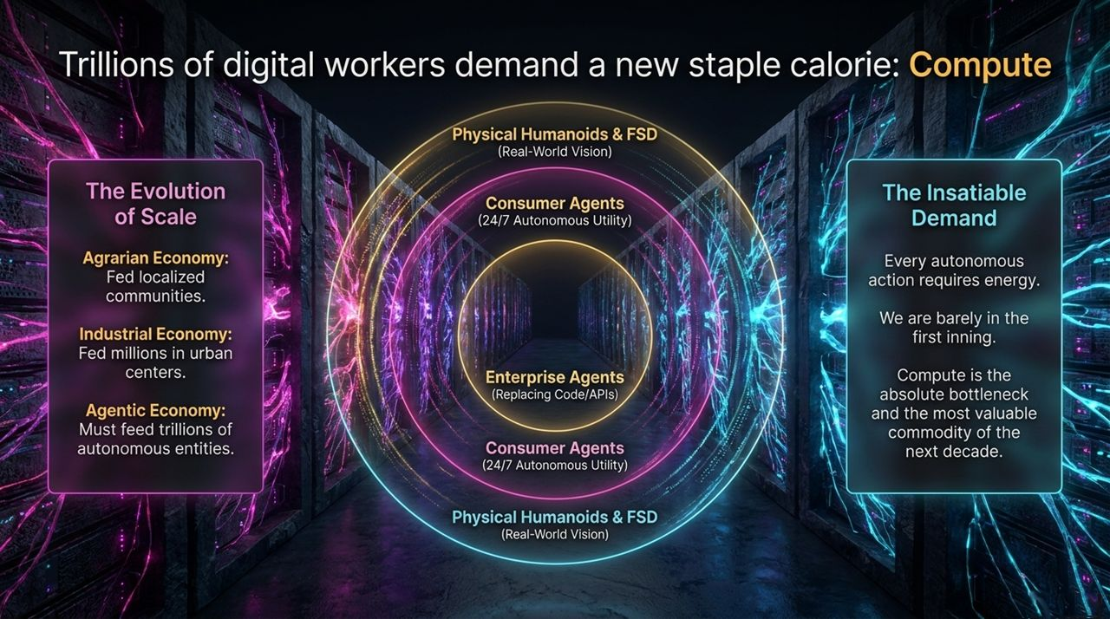
Notes:
Slide 11 brings us to one of the most profound macroeconomic implications of this entire deck: How programmable assets permanently alter the global liquidity cycle.
Look at the Activation Curve chart displayed on the slide. Notice how volatility flattens into a smooth, continuous upward trajectory once activation takes place. Here is the mechanism behind that chart:
The M2 Replacement Mechanism:
As we established on Slide 2, central banks traditionally have to print fiat M2 to save illiquid asset markets from crashing during a panic.
Tokenization fundamentally replaces this central bank printing press.
When real-world assets are tokenized, the assets themselves effectively become M2 money.
Ending the Central Bank Panic Engine:
Consider this scenario: If a $5 million commercial building is tokenized and fractionally tradable on-chain in real-time, it possesses near-instant liquidity.
If the owner needs cash instantly to settle a debt or buy an asset, they don't need a bank loan or a bailout. A smart contract automatically liquidates 0.05% of the property's tokenized equity in milliseconds to settle the transaction.
When every asset class—from real estate to private debt—can instantly buy a cup of coffee via algorithmic smart-contract routing, the necessity for panic-selling and central bank money printing evaporates.
Tokenization cures the liquidity mismatch that has plagued fractional-reserve fiat banking for over a century. It transitions global finance from central-bank-dependent stability to native, programmatic liquidity.

Slide 12
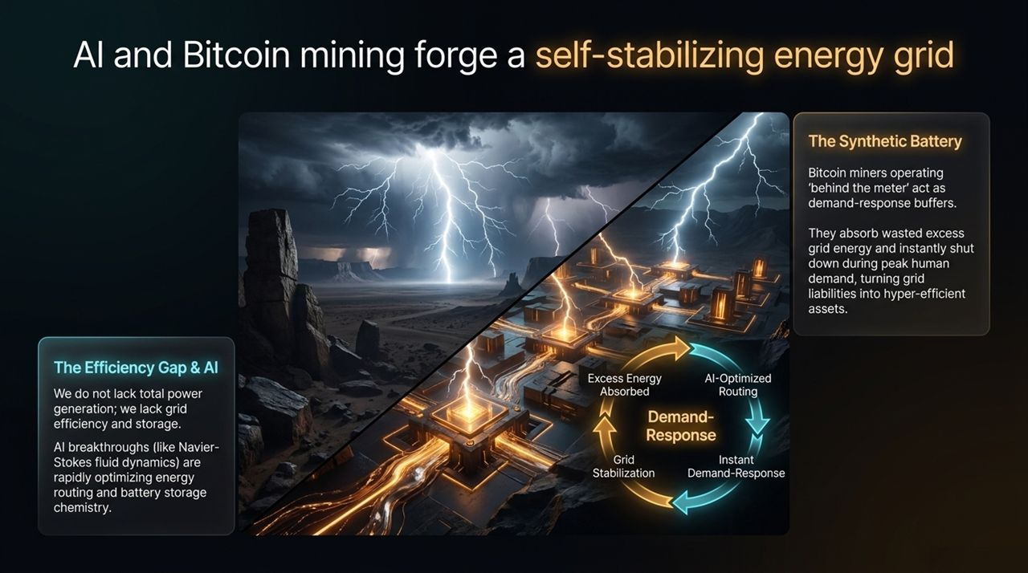
Notes:
If AI agents make innovation hyper-fast, and tokenization makes assets hyper-liquid, what happens to company valuations and equity markets? Slide 12 addresses the ultimate destination for capital in a world of hyper-velocity.
The Death of the Corporate Moat:
In a legacy economy, a successful software or service company could enjoy a competitive "moat" for decades.
In a world dominated by super-intelligent AI agents and autonomous digital entrepreneurs, Schumpeterian "Creative Destruction" happens almost instantaneously.
If a SaaS company builds a profitable product today, autonomous AI agents can clone, optimize, and distribute a better, cheaper version within months. Corporate moats evaporate overnight, compressing long-term growth cycles for equity investments.
The Flight to Safety:
When technological innovation erodes the long-term defensibility of corporate equities, where does capital go to preserve its value over decades?
Capital flees away from software assets that can be out-engineered and searches for an unchangeable, immutable base layer that cannot be out-engineered or diluted.
Bitcoin as the Terminal Asset:
This makes Bitcoin the ultimate terminal store of value.
While AI agents destroy margins in equity markets and out-compete traditional software, Bitcoin’s monetary policy is fixed in code. It cannot be copied, diluted, or disrupted by an algorithm.
As technological acceleration decays the long-term terminal value of legacy equities, Bitcoin stands as the absolute, neutral bedrock asset for human and machine capital alike.

Slide 13
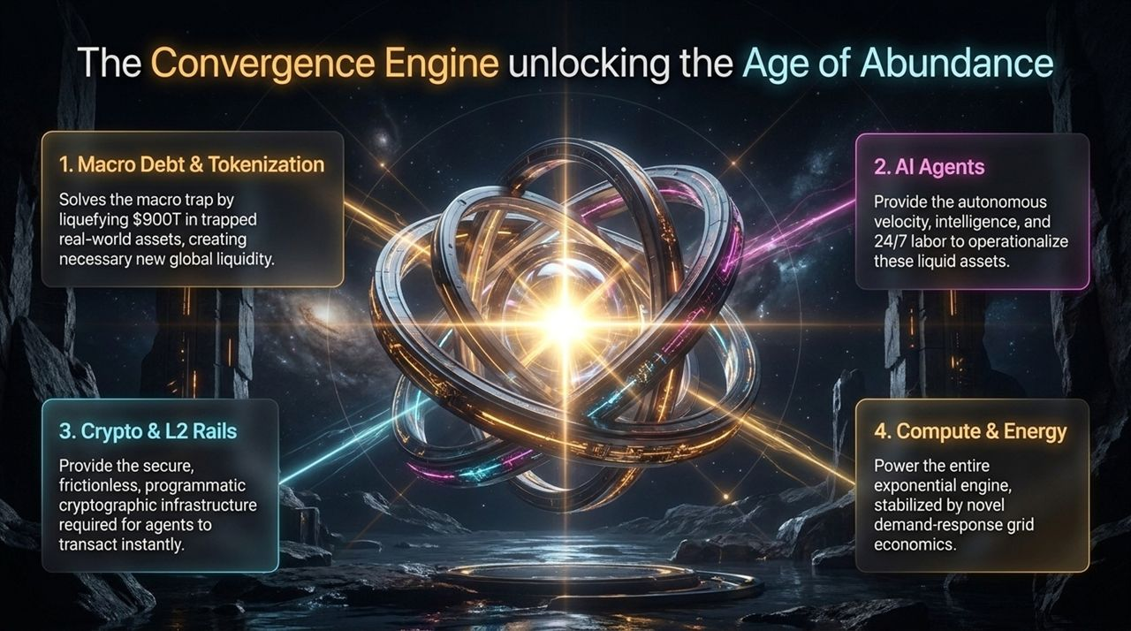
Notes:
Now let's examine the physical backbone required to power these trillions of digital workers: Energy and Compute.
The Evolution of Economic Scale:
Agrarian Economy: Scaled energy to feed localized human communities.
Industrial Economy: Scaled power to feed millions of urban factory workers.
Agentic Economy: Must scale compute to feed trillions of autonomous entities—including Consumer Agents, Enterprise Code Agents, Physical Humanoids, and Full Self-Driving (FSD) vision networks.
The Insatiable Demand for Compute:
Every single autonomous thought, smart contract execution, and AI model inference requires raw kilowatt-hours of power.
We are only in the very first inning of this trend. Compute is no longer just a tech commodity—it is the foundational staple calorie of the next century.
AI & Bitcoin Mining: Forging a Self-Stabilizing Energy Grid:
How do we power this without collapsing electrical grids? Through the convergence of AI grid management and Bitcoin mining.
The Efficiency Gap: The world doesn't lack total energy generation; we suffer from inefficient grid routing and energy storage bottlenecks. Advanced AI models (solving complex physics like Navier-Stokes fluid dynamics) are rapidly optimizing energy distribution and battery chemistry.
The Synthetic Battery: Bitcoin miners act as the ultimate flexible load. Operating 'behind the meter,' they absorb excess, wasted energy from remote renewable sources. When human or AI grid demand surges, Bitcoin miners instantly power down in milliseconds, acting as a hyper-efficient demand-response buffer.
Together, AI optimization and Bitcoin energy loads turn fragile power grids into highly resilient, self-stabilizing energy engines.

Slide 14
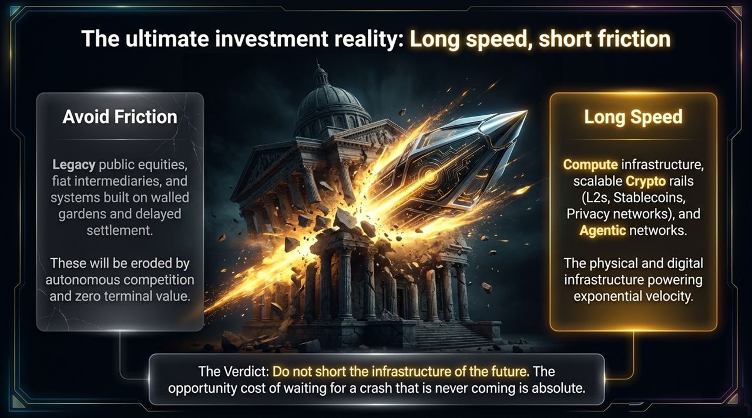
Notes:
Slide 14 brings every single thread of this deck together into one unified framework: The Convergence Engine.
Look at the central Gyroscope visual on this slide. It illustrates how these four pillars lock together to unlock the Age of Abundance:
Macro Debt & Tokenization: Solves the legacy macroeconomic debt trap by liquefying $900 trillion in trapped assets, creating organic, non-inflationary global liquidity.
AI Agents: Provide the autonomous labor force, transaction velocity, and continuous intelligence needed to operationalize and trade these tokenized assets 24/7.
Crypto & L2 Rails: Provide the permissionless, cryptographic, instant-settlement rails that give AI agents their native financial system.
Compute & Energy: Serves as the physical fuel for the entire engine, stabilized by AI-driven grid optimization and Bitcoin mining demand-response economics.
Remove any one of these four pillars, and the engine stalls. Together, they form an interconnected, self-reinforcing flywheel that moves humanity out of legacy fiat friction and into an era of unprecedented speed, productivity, and abundance.

Slide 15
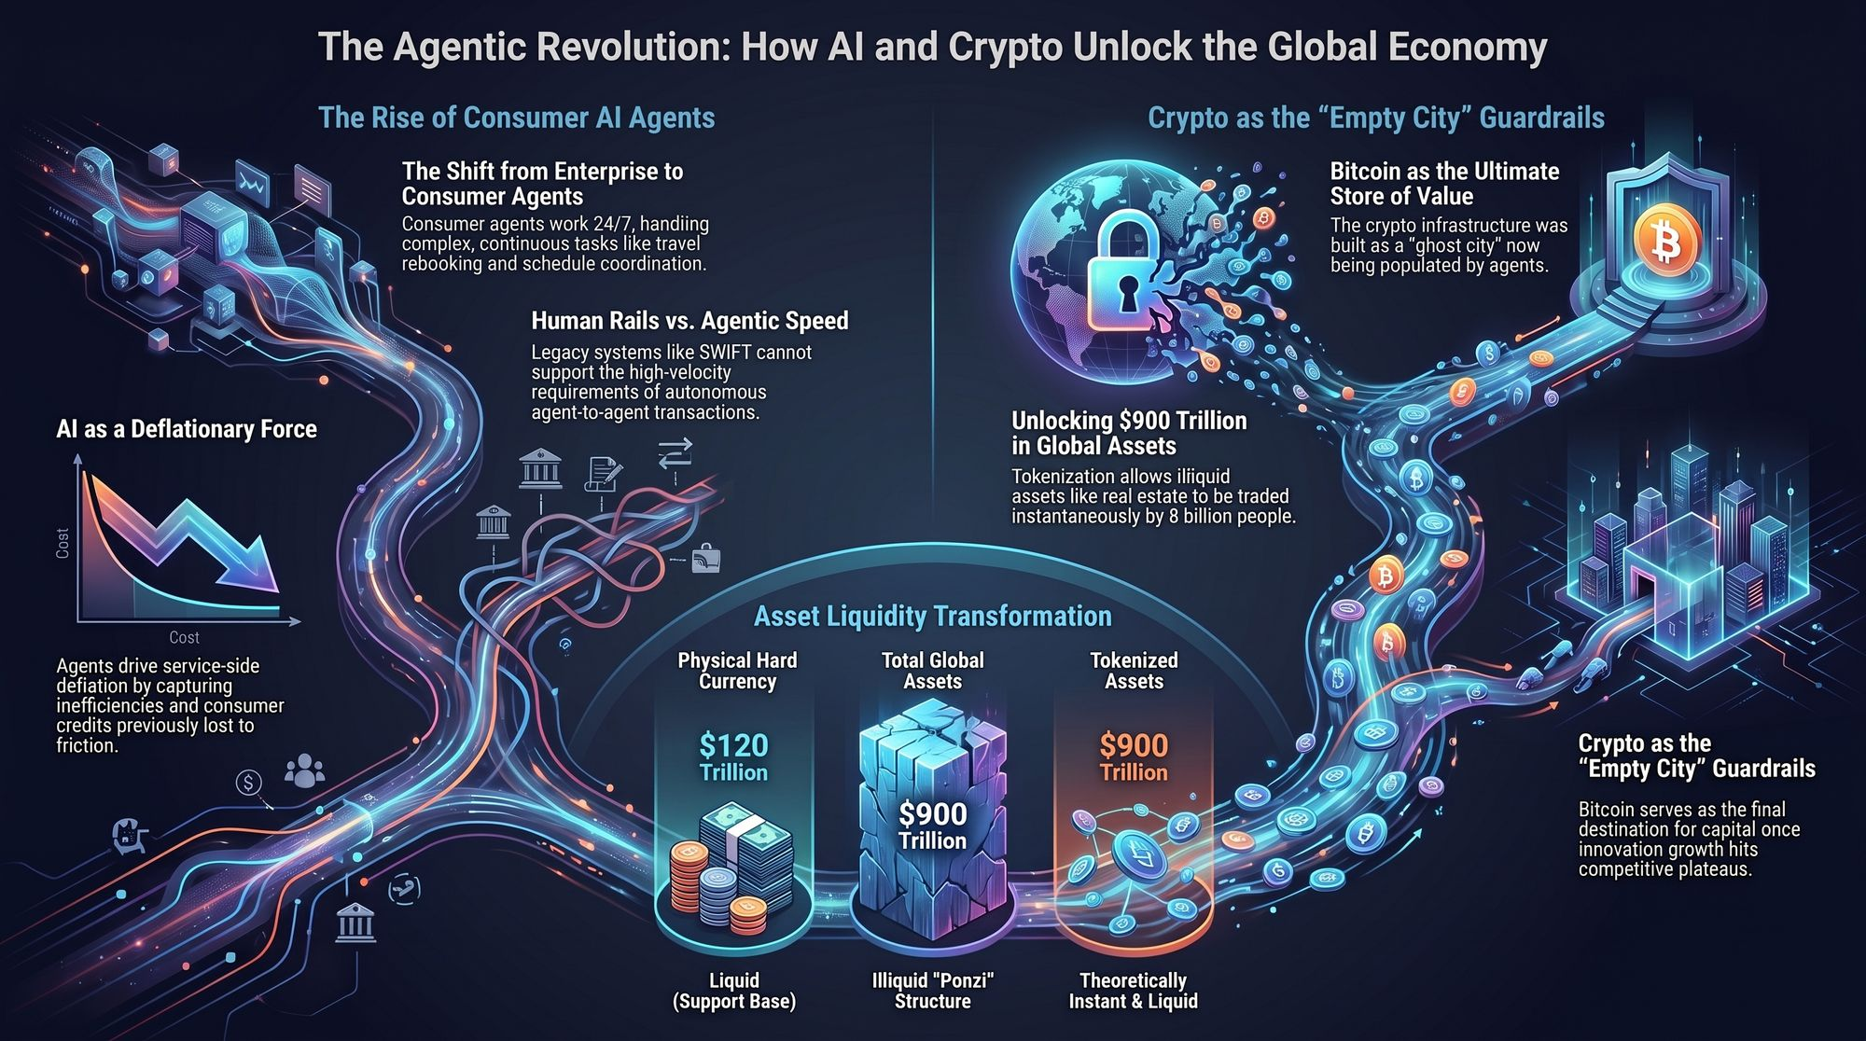
Notes:
To conclude our presentation, let’s talk about actionability. What is the ultimate investment and strategic verdict of this paradigm shift?
It comes down to a simple four-word rule: Avoid Friction. Long Speed.
What to Avoid (Short Friction):
Steer clear of legacy public equities and financial intermediaries that rely on physical geography, manual processes, 9-to-5 operating hours, and closed walled gardens.
Businesses built on extracting fees from slow settlement, administrative delays, and regulatory moats will see their profit margins relentlessly eroded by autonomous AI competition. Their terminal value is trending toward zero.
What to Allocate To (Long Speed):
Deploy capital directly into the physical and digital infrastructure powering exponential velocity.
This means Compute and Energy infrastructure, scalable Crypto rails (Layer-2 networks, stablecoin issuers, privacy protocols), and Agentic software networks.
The Final Verdict:
Look at the graphic on the slide: the rocket of technological speed shattering the old pillars of legacy financial institutions.
Do not short the infrastructure of the future. Investors waiting on the sidelines for a traditional macroeconomic crash to clear the deck are fundamentally misinterpreting the landscape. The opportunity cost of waiting for a crash that is never coming is absolute.
Thank you very much. I am now open to taking your questions.
The $900 Trillion Trigger That Sends Bitcoin Parabolic | Jordi Visser
https://www.youtube.com/watch?v=VkDpGZ_KsrY

